Slide 1

A Bite of My Hometown
Let’s Take a Bite of WenZhou and Hangzhou
Presenter
Hemingyuan

Slide 2
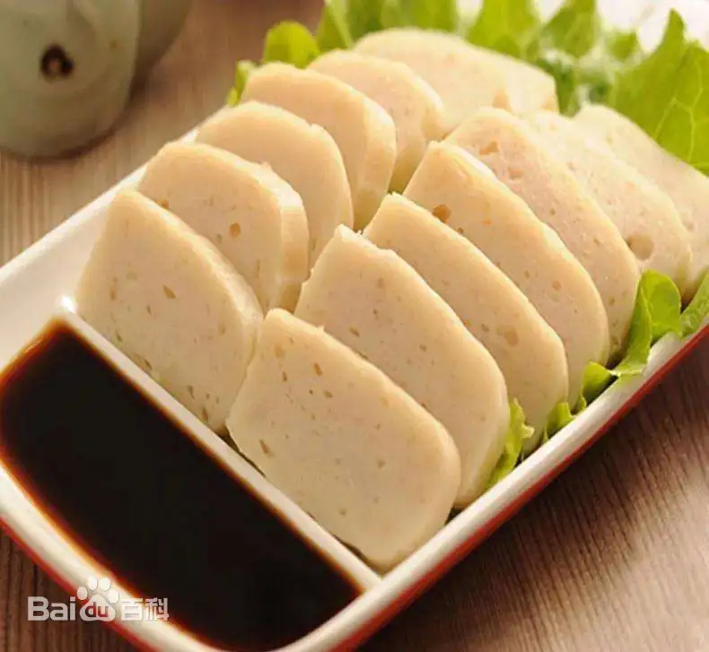
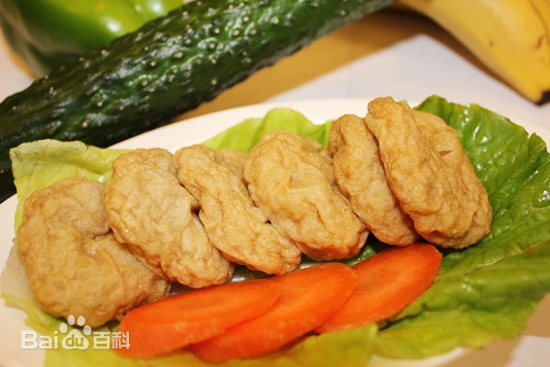
A Bite of Wenzhou Wenzhou FishCake

Slide 3
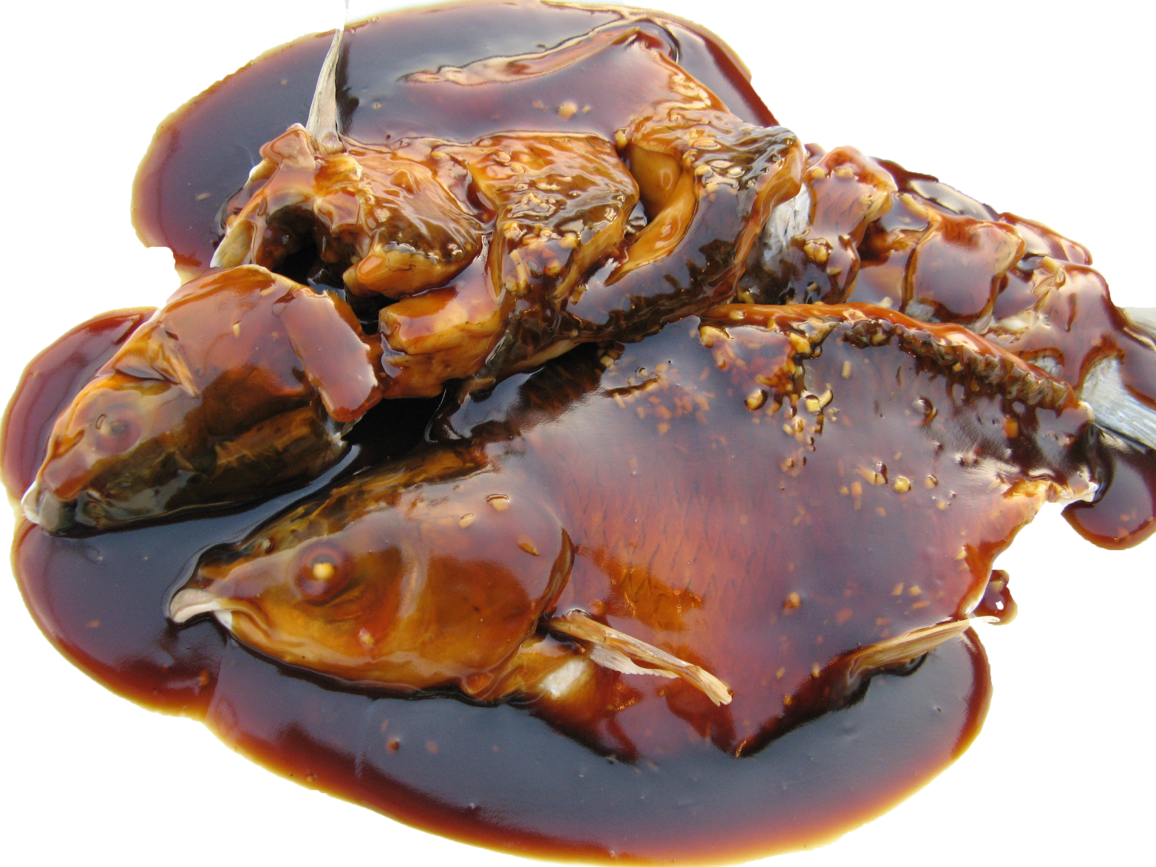
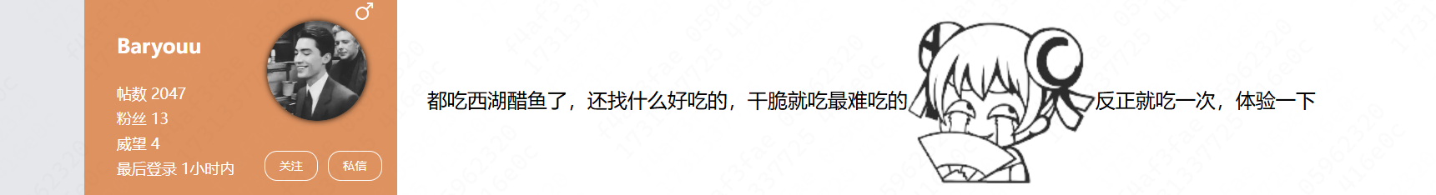
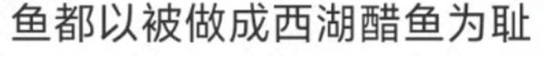
A Bite of HangZhou West Lake Fish in Vinegar Gravy

